Slide 1


Trinh Bao Khanh Huyen
19 Feb 2024

Slide 2

Outline
Executive Summary
Introduction
Methodology
Results
Conclusion
Appendix

Slide 3
Executive Summary
Summary of methodologies
Data collection through API
Data Collection with Web Scraping
Data Wrangling
Exploratory Data Analysis with SQL
Exploratory Data Analysis with Data Visualization
Interactive Visual Analytics with Folium
Machine Learning Prediction
Summary of all results
Exploratory Data Analysis result
Interactive analytics in screenshots
Predictive Analytics result

Slide 4
Introduction
Project background and context
Space X advertises Falcon 9 rocket launches on its website with a cost of 62 million dollar.
Other providers cost upward of 165 million dollars each
Much of the savings is because Space X can reuse the first stage.
If it is possible to predict the outcome of first stage, the cost of a launch is determined. It is useful if an alternate company wants to bid against space X for a rocket launch.
This goal of the project is to create a machine learning pipeline to predict if the first stage will land successfully
Problems you want to find answers
What factors determine if the rocket will land successfully?
The interaction amongst various features that determine the success rate of a successful landing.
What operating conditions needs to be in place to ensure a successful landing program.

Slide 5

Section 1

Slide 6
Methodology
Executive Summary
Data collection methodology:
Web scraping: https://en.wikipedia.org/wiki/List_of_Falcon/_9/_and_Falcon_Heavy_l aunches
Requesting rocket launch data from SpaceX API: "https://api.spacexdata.com/v4/launches/past"
Perform data wrangling:
Collect data and enriched using outcome label based on outcome data.

Slide 7
Methodology
Executive Summary
Perform exploratory data analysis (EDA) using visualization and SQL
Perform interactive visual analytics using Folium and Plotly Dash
Perform predictive analysis using classification models
At this step, data is normalized, divided into training and test data sets.
These data set are tested on 4 different models to find the method performs best using test data.
Different parameters are used to find the most suited model.

Slide 8
Data Collection
Describe how data sets were collected.
Datasets were collected from SpaceX API (https://api.spacexdata.com/v4/rockets/) and from Wikipedia (https://en.wikipedia.org/wiki/List_of_Falcon/_9/_and_Falcon_Heavy_launches), using web scraping technics.

Slide 9
Data Collection – SpaceX API
Import libraries and define auxiliary functions
Check the response status, get the file from url
Get the file decoded as Json, turn into a Pandas data frame
Check data source and format
Using API to get information about each launch using launch ID
SpaceX offers a public API from where data can be obtained and then used;
• This API was used according to the flowchart beside and then data is persisted.
GitHub URL: https://github.com/JennTrinh/Data-Sci--Coursera---Capstone/blob/a5f256a2454bf095fdc4bf3fac6fb987ccbdf180/Wk1-labs-spacex-data-collection-api.ipynb

Slide 10
Data Collection - Scraping
Extract column/variable names from HTML table header
Create an empty dictionary with keys being the extracted column names
Combine the columns into a dictionary.
Create a dataframe from dictionary
Request Falcon 9 Launch wiki page from its URL
Data from SpaceX launches can also be obtained from Wikipedia;
Data are downloaded from Wikipedia according to the flowchart and then persisted.
GitHub URL: https://github.com/JennTrinh/Data-Sci--Coursera---Capstone/blob/a5f256a2454bf095fdc4bf3fac6fb987ccbdf180/Wk1-labs-webscraping.ipynb

Slide 11
Data Wrangling
Initially some Exploratory Data Analysis (EDA) was performed on the dataset.
Then the summary launches per site, occurrences of each orbit and occurrences of mission outcome per orbit type were calculated.
Finally, the landing outcome label was created from Outcome column.
GitHub URL: https://github.com/JennTrinh/Data-Sci--Coursera---Capstone/blob/a5f256a2454bf095fdc4bf3fac6fb987ccbdf180/Wk1-labs-spacex-Data%20wrangling.ipynb
Determine training labels: create landing outcome label
Perform exploratory data analysis
Identify missing values, check data types

Slide 12
EDA with Data Visualization
Summarize what charts were plotted and why you used those charts:
Scatter point chart with Flight Number and the launch site: Visualize the relationship between Flight Number and Launch Site.
Scatter point chart with Pay Load Mass (kg) and the launch site: observe if there is any relationship between launch sites and their payload mass.
Bar chart for the success rate of each orbit: visually check if there are any relationship between success rate and orbit type to find which orbits have high success rate.
Scatter point chart with Flight Number and the Orbit: check if there is any relationship between Flight Number and Orbit type.
Scatter point chart with Payload and the Orbit: reveal the relationship between Payload and Orbit type.
Line chart with year and the success rate: to get the average launch success trend.
GitHub URL: https://github.com/JennTrinh/Data-Sci--Coursera---Capstone/blob/a5f256a2454bf095fdc4bf3fac6fb987ccbdf180/Wk2-labs-eda-dataviz.ipynb

Slide 13
EDA with SQL
The following SQL queries were performed:
Names of the unique launch sites in the space mission
Top 5 launch sites whose name begins with the string 'CCA’
Total pay load mass carried by boosters launched by NASA (CRS)
Average payload mass carried by booster version F9 v1.1
List the date when the first successful landing outcome in ground pad was achieved
Names of the boosters which have success in drone ship and have payload mass between 4000 and 6000 kg
Total number of successful and failure mission outcomes
Names of the booster versions which have carried the maximum payload mass
Success/Failed landing out comes in droneship, their booster versions, and launch site names for in year 2015
Rank of the count of landing outcomes (such as Failure (droneship) or Success (ground pad)) between the date 2010-06-04 and 2017-03-20
GitHub URL: https://github.com/JennTrinh/Data-Sci--Coursera---Capstone/blob/a5f256a2454bf095fdc4bf3fac6fb987ccbdf180/Wk2-labs-eda-sql-coursera_sqllite.ipynb

Slide 14
Build an Interactive Map with Folium
Mark the launch sites on map:
- Adding folium.Marker to mark the area and adding folium.Circle to add a highlighted circle area with a text label on a specific coordinate.
Mark the success / failure launches for each site on map:
- Using the green marker for success and red marker for failure launches.
Creating a MarkerCluster object to simplify a map containing many markers having the same coordinate.
Adding a folium.Marker to marker cluster object for each launch site result to easily identify which launch sites have relatively high success rates.
Github url: https://github.com/JennTrinh/Data-Sci--Coursera---Capstone/blob/a5f256a2454bf095fdc4bf3fac6fb987ccbdf180/Wk3-lab_jupyter_launch_site_location.ipynb

Slide 15
Build a Dashboard with Plotly Dash
Plots/graphs and interactions added to a dashboard:
Pie chart to show the total successful launches count for all sites and selected site: the proportion of success rate from all launch sites to observe which launch site counted largest percentage as well as the success rate within the selected launch site.
Scatter chart to show the correlation between payload and launch success: whether there is a relationship between payload and success rate of booster versions and which booster version perform best.
Add the GitHub URL: https://github.com/JennTrinh/Data-Sci--Coursera---Capstone/blob/a5f256a2454bf095fdc4bf3fac6fb987ccbdf180/Wk3-spacex_dash_app.py

Slide 16
Predictive Analysis (Classification)
Perform exploratory Data Analysis and determine Training Labels
Create a column for the class
Find best Hyperparameter for SVM, Classification Trees and Logistic Regression
Standardize the data
Split into training data and test data
Find best method perform best
Using different metrics to calculate scores.
Test on parameters
GitHub URL: https://github.com/JennTrinh/Data-Sci--Coursera---Capstone/blob/a5f256a2454bf095fdc4bf3fac6fb987ccbdf180/SpaceX_Machine_Learning_Prediction_Part_5.jupyterlite.ipynb

Slide 17
Results
Exploratory data analysis results
Interactive analytics demo in screenshots
Predictive analysis results

Slide 18

Section 2

Slide 19
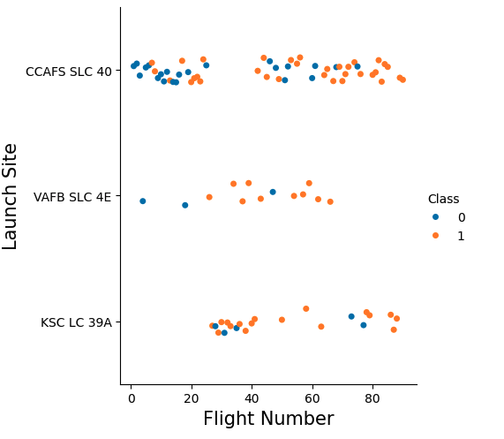
Flight Number vs. Launch Site
Discovery if there is any relationship between the success rate, flight number and launch site.
After flight number 40, there are higher success rate in all 3 launch sites.
Relationship between Flight Number and Launch Site
Discovery whether the

Slide 20
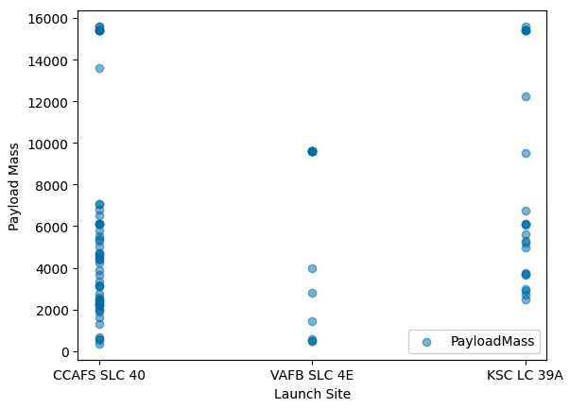
Payload vs. Launch Site
Discovery if there is any relationship between launch sites and their payload mass
At the VAFB-SLC launch site, there are no rockets launched for heavy payload mass (>10000)
Relationship between Payload and Launch Site

Slide 21
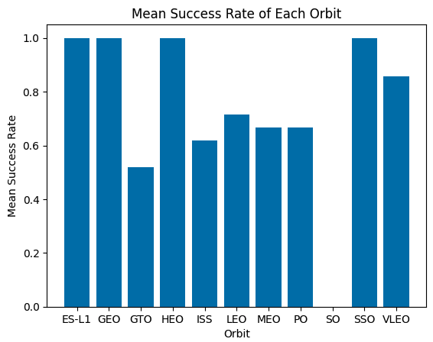
Success Rate vs. Orbit Type
Discovery if there is any relationship between success rate and orbit type
SO orbit has no success rate, orbits having the highest success were ES-L1, HEO, SSO and VLEO
Relationship between Success rate and Orbit type

Slide 22
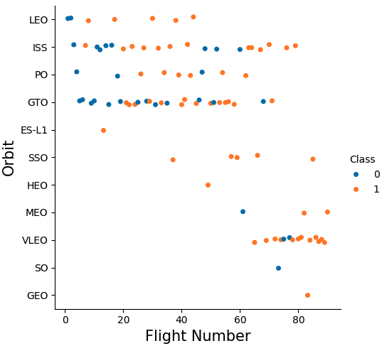
Flight Number vs. Orbit Type
Discovery if there is any relationship between Flight number and Orbit type
The LEO orbit the Success appears related to the number of flights.
On the other hand, there seems to be no relationship between flight number when in GTO orbit
Relationship between Flight number and Orbit type

Slide 23
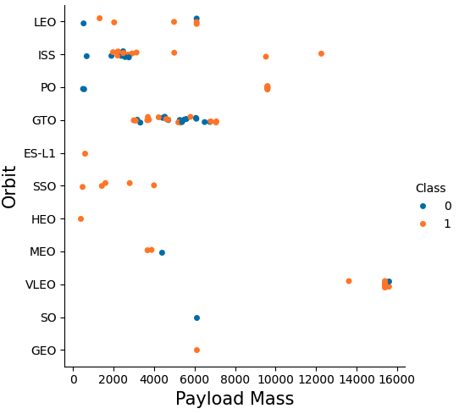
Payload vs. Orbit Type
Discovery if there is any relationship between Payload and Orbit type
With heavy payloads the successful landing or positive landing rate are more for Polar, LEO and ISS.
At the GTO launch site, both success and unsuccessful mission cannot be distinguished well.
The relationship between Payload and Orbit type

Slide 24
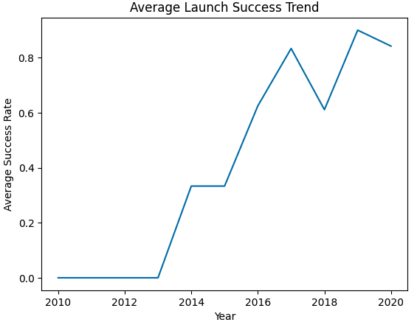
Launch Success Yearly Trend
Visualizing trending of the launch success yearly
There was a short increasing in success rate from 2013 to 2014.
Success rate increased again in 2015 after stabilizing in 2014 and kept the trend till 2017.
Visualization of average launch success trend yearly

Slide 25
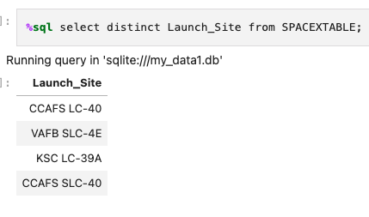
All Launch Site Names
Get all the launch site name using distinct combine with select function
%sql select distinct Launch_Site FROM SPACEXTABLE;

Slide 26
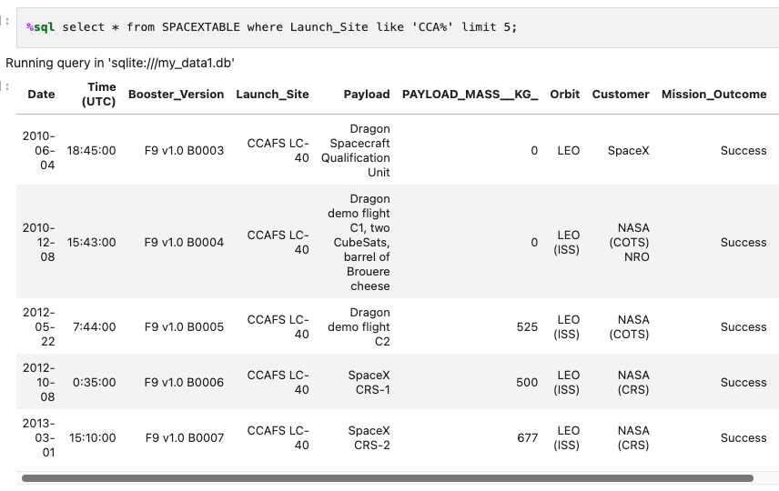
Launch Site Names Begin with 'CCA'
Find 5 records where launch sites begin with `CCA`: the records are chosen using * to collect all information from every column, adding condition ‘CCA%’ and limit 5.

Slide 27
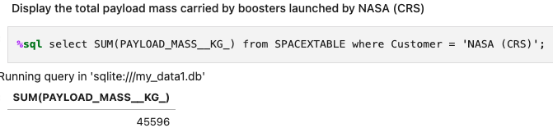
Total Payload Mass
Calculate the total payload carried by boosters from NASA: calculation is made using SUM with the PAYLOAD_MASS__KG_ column with condition as Customer = ‘NASA (CRS)’
%sql select SUM(PAYLOAD_MASS__KG_) from SPACEXTABLE where Customer = 'NASA (CRS)’;

Slide 28
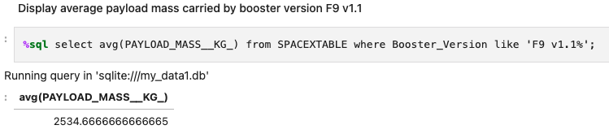
Average Payload Mass by F9 v1.1
Calculate the average payload mass carried by booster version F9 v1.1: calculation is made using avg on PAYLOAD_MASS__KG_ column and condition is added as where Booster_Version like ‘F9 v1.1%’.

Slide 29
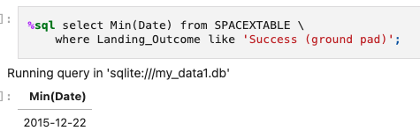
First Successful Ground Landing Date
Find the dates of the first successful landing outcome on ground pad: get the smallest date using Min on Date column, with condition where Landing_Outcome like ‘Success (ground pad)’

Slide 30
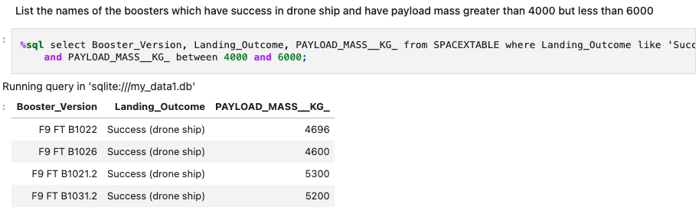
Successful Drone Ship Landing with Payload between 4000 and 6000
List the names of boosters which have successfully landed on drone ship and had payload mass greater than 4000 but less than 6000: using select function on multiple columns to satisfy the requirement by adding condition where Landing_Outcome like 'Success (drone ship)' and PAYLOAD_MASS__KG_ between 4000 and 6000
%sql select Booster_Version, Landing_Outcome, PAYLOAD_MASS__KG_ from SPACEXTABLE where Landing_Outcome like 'Success (drone ship)' and PAYLOAD_MASS__KG_ between 4000 and 6000;

Slide 31
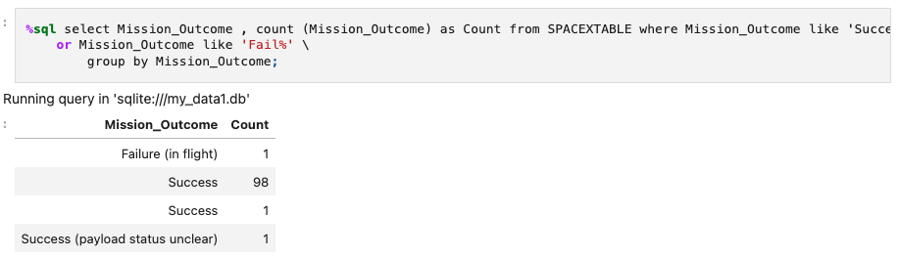
Total Number of Successful and Failure Mission Outcomes
Calculate the total number of successful and failure mission outcomes: adding multiple conditions Mission_Outcome like 'Success%’ or Mission_Outcome like 'Fail%' group by Mission_Outcome, and adding a new column to the result table as Count being the result from count function of Mission_Outcome column
%sql select Mission_Outcome , count (Mission_Outcome) as Count from SPACEXTABLE where Mission_Outcome like 'Success%’ or Mission_Outcome like 'Fail%' group by Mission_Outcome;

Slide 32
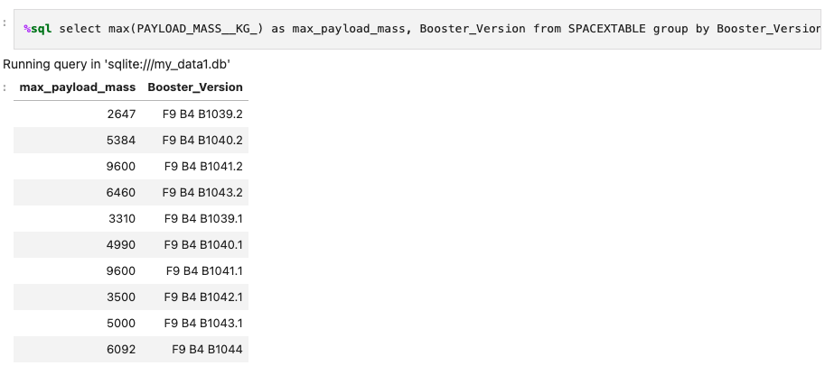
Boosters Carried Maximum Payload
List the names of the booster which have carried the maximum payload mass: using the sub query as the condition to combine with the main query after where clause
%sql select Booster_Version, max(PAYLOAD_MASS__KG_) as max_payload_mass from SPACEXTABLE where PAYLOAD_MASS__KG_ = (select max(PAYLOAD_MASS__KG_) as max_payload_mass from SPACEXTABLE);

Slide 33
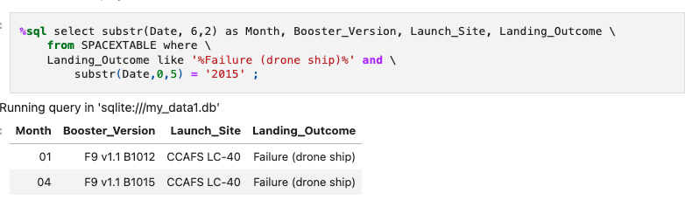
2015 Launch Records
List the failed landing_outcomes in drone ship, their booster versions, and launch site names for in year 2015.: using multiple conditions and function substr to extract the year from Date column as part of condition after where clause.
%sql select substr(Date, 6,2) as Month, Booster_Version, Launch_Site, Landing_Outcome from SPACEXTABLE where Landing_Outcome like '%Failure (drone ship)%' and substr(Date,0,5) = '2015’ ;

Slide 34
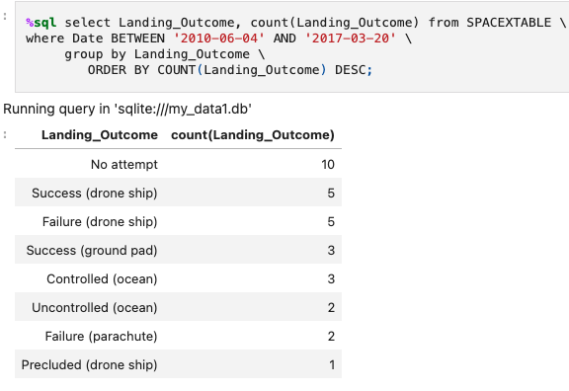
Rank Landing Outcomes Between 2010-06-04 and 2017-03-20
Rank the count of landing outcomes (such as Failure (drone ship) or Success (ground pad)) between the date 2010-06-04 and 2017-03-20, in descending order: using multiple condition in where clause and combine order by, group by to rank the count in descending order.

Slide 35

Section 3

Slide 36
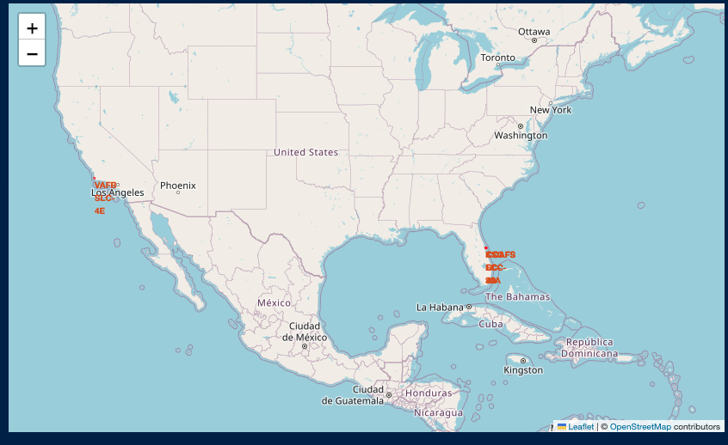
Launch sites marked on Map
The locations are marked using red color with names using coordinate from data set, the markers were made by using folium.Marker and folium.Circle.
From the map, it is possible to observe that all the launch site locations are relatively close to the coast and proximity to the Equator line.

Slide 37
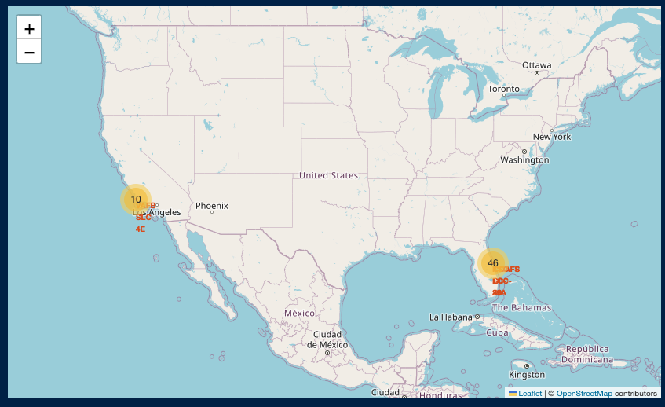
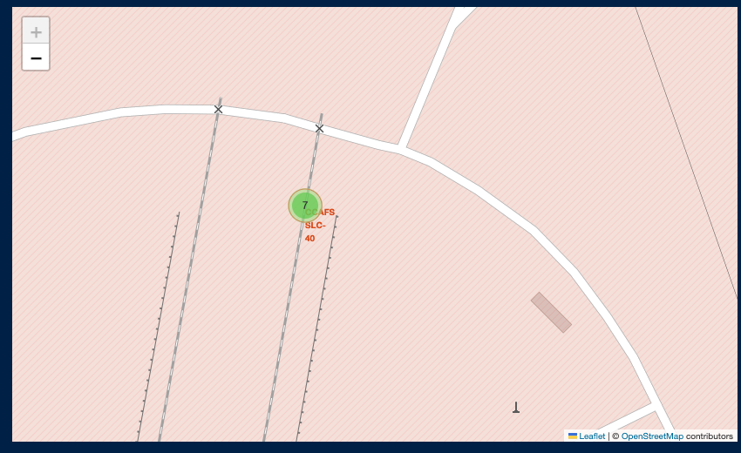
Success/Failed launches for each site on Map
The launch sites are marked on map along with outcomes of each launch.
The success launches are marked with green and red represents failed launch.
From the map, it is possible to get the information of the sites having high success rates.

Slide 38
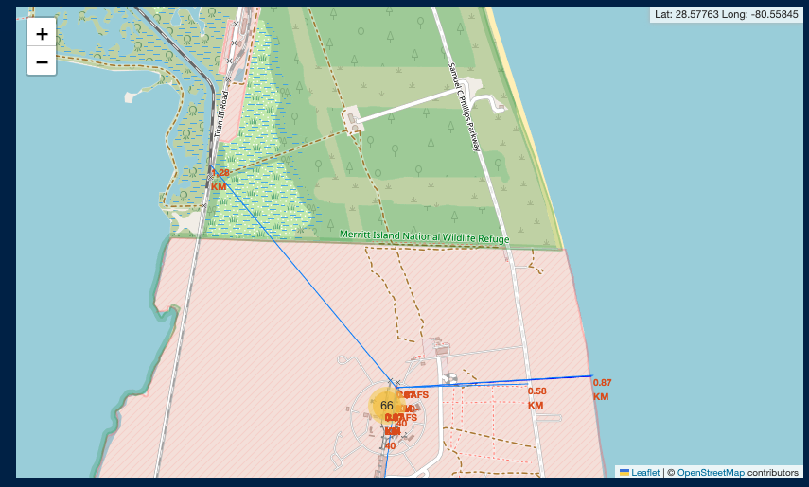
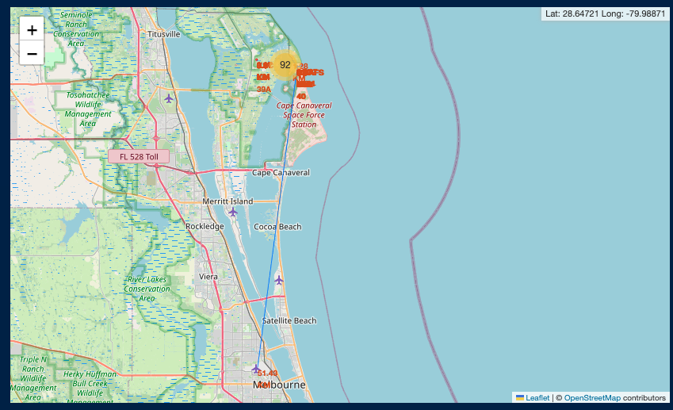
Distance between a launch site to its proximities
The distance lines to the proximities are shown by a blue line.
Between the launch site and travelling stations is relatively close, these stations are railways, highways, airport.
Also, it is possible to notice that the launch site locations are not close the nearby major cities.
The findings suggest that there are some considerations about the location of these launch sites to make it efficient to travel and to comply with safety standard.

Slide 39

Section 4

Slide 40
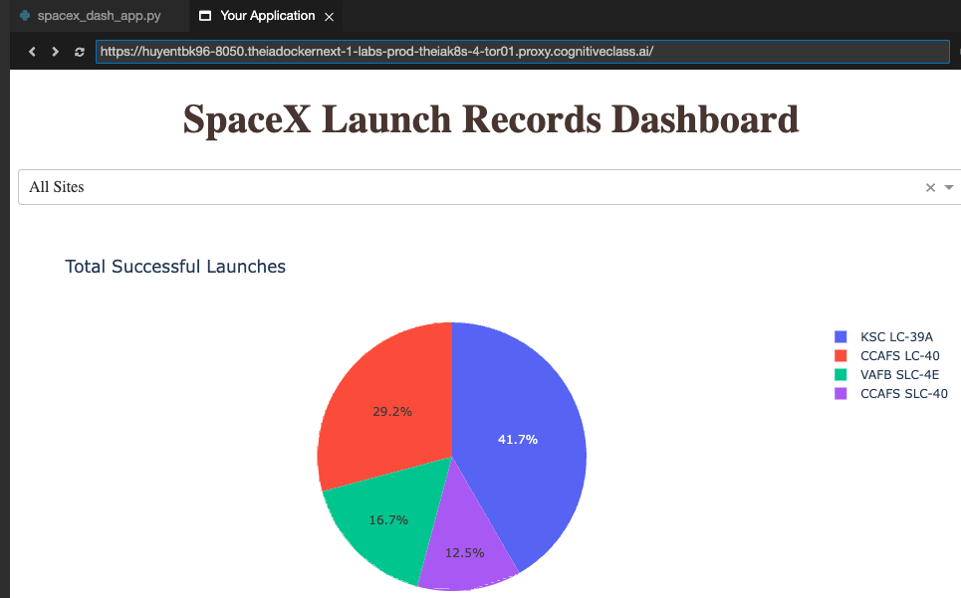
Launch success count for all sites
All the launch sites shown in the pie chart is colored along with the success rates.
The launch site with highest success count is KSC LC-39A

Slide 41
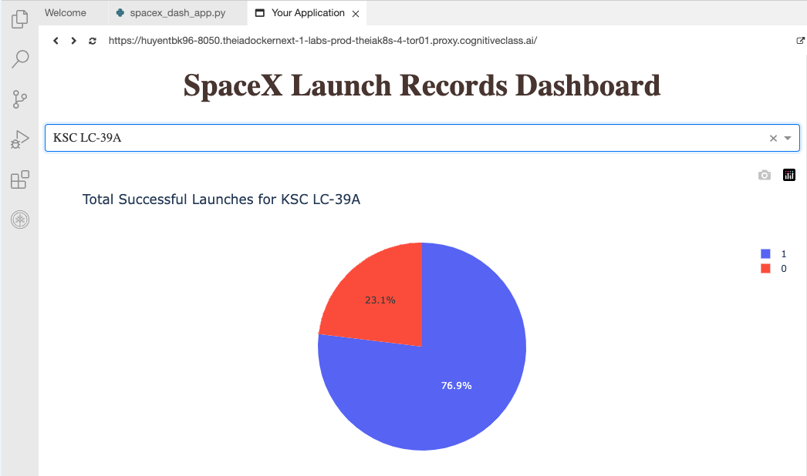
Launch site with highest launch success ratio
From previous plot, it is easy to observe that KSC LC-39A has the highest success rate.
Even that, this launch site still has that proportion of failure around 23.1 %.

Slide 42
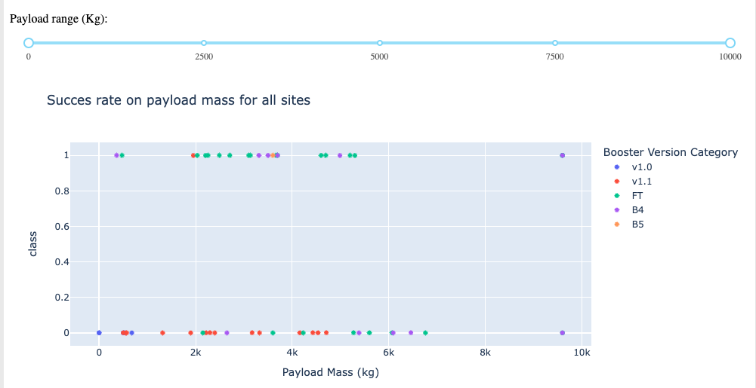
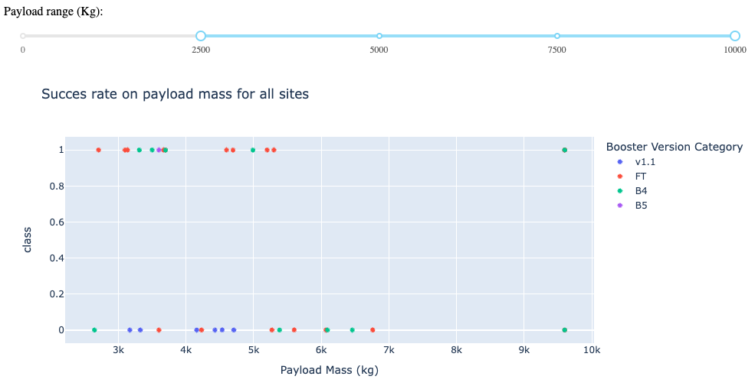
Payload may be correlated with mission outcomes for all sites
All over, The booster version with the highest success rate belongs to FT, still it is worth to mention B4 as well.
But in considerations with different payload range, it is possible to see how well other booster versions perform.

Slide 43

Section 5

Slide 44
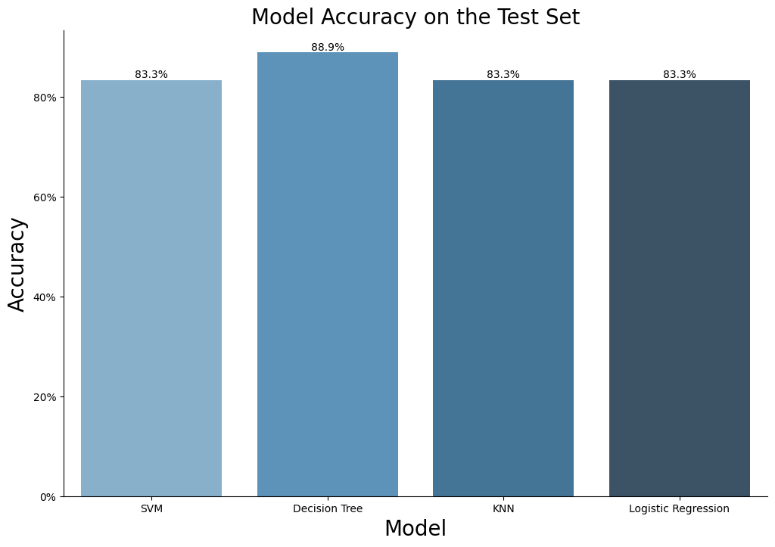
Classification Accuracy
The model has the highest accuracy score is Decision Tree

Slide 45

Confusion Matrix
The confusion matrix for the decision tree classifier shows that the classifier can distinguish between the different classes. The major problem is the false positives .i.e., unsuccessful landing marked as successful landing by the classifier.

Slide 46
Conclusions
The larger the flight amount at a launch site, the greater the success rate at a launch site.
Launch success rate started to increase in 2013 till 2020.
Orbits ES-L1, GEO, HEO, SSO, VLEO had the most success rate.
KSC LC-39A had the most successful launches of any sites.
The Decision tree classifier is the best machine learning algorithm for this task.

Slide 47


